Slide 1
PREDICTING POSSIBLE DEFAULTERS FOR A CONSUMER LOAN PRODUCT

Slide 2
1
Problem Statement
Data Preparation
2
Data Exploration
Modeling
3
Evaluation
Deployment
MODELING
PROCESS

Slide 3
PROBLEM DEFINITION
BUILD A LOAN DEFAULT PREDICTION MODEL FO FINANCIAL INSTITUITIONS USING PAST DATA COLLECTED TO ACCESS THE LIKELIHOOD OF DEFAULT BY THE BORROWER

Slide 4
DATA
There are 252,000 data points in the training dataset and 28000 in test dataset.
The entire dataset contains 13 different features containing 7 numerical and 6 categorical columns.
Risk flag is the target variable classifying whether an applicant will be able to pay off the loan or default.
No missing values and outliers present

Slide 5
DATA EXPLORATION
DATA EXPLOATION
UNIVARIATE ANALYSIS
AVERAGE, MIN, MAX, FREQUENCY ETC
BAR CHART, PIE CHART
BIVARIATE ANALYSIS
CORRELATION, CHI-SQUARE TEST
COMBINATION
CHARTS

Slide 6
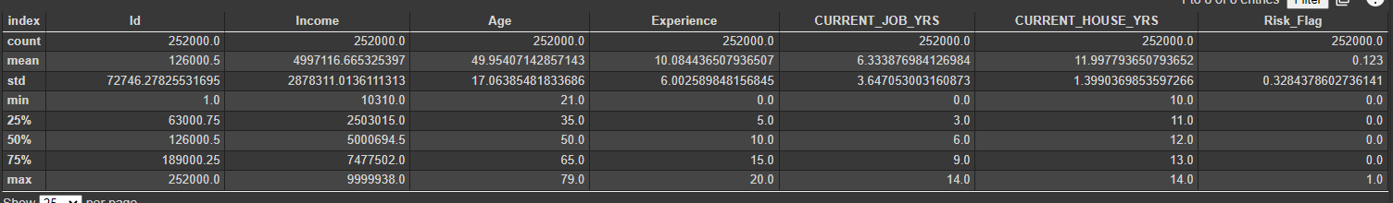
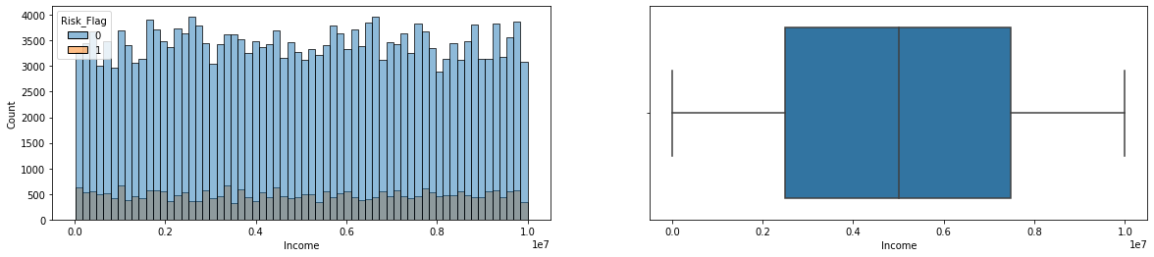
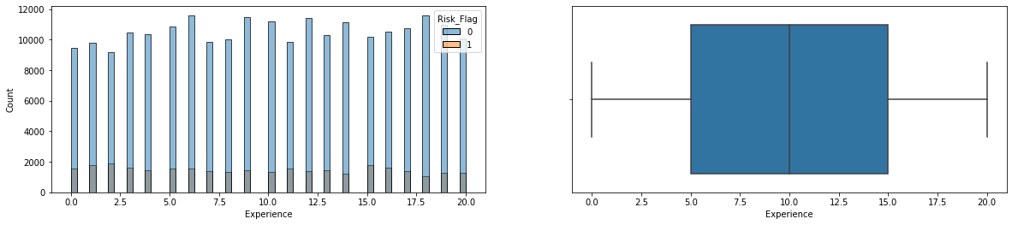
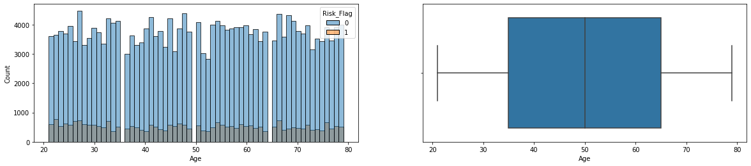
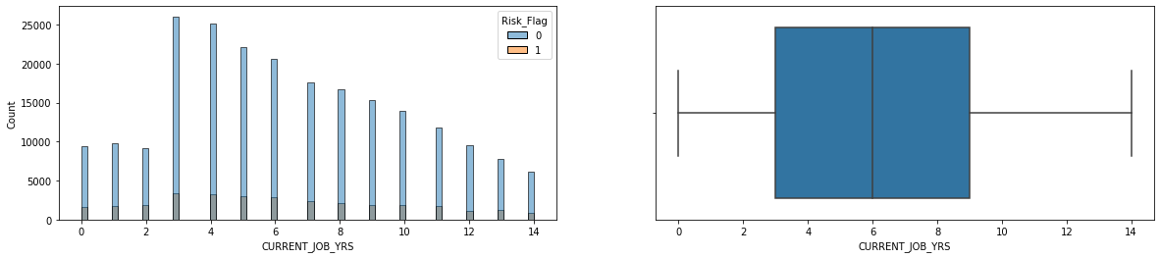
UNIVARIATE ANALYSIS

Slide 7
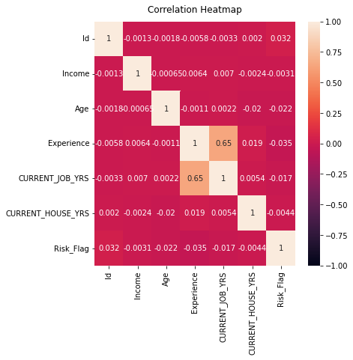
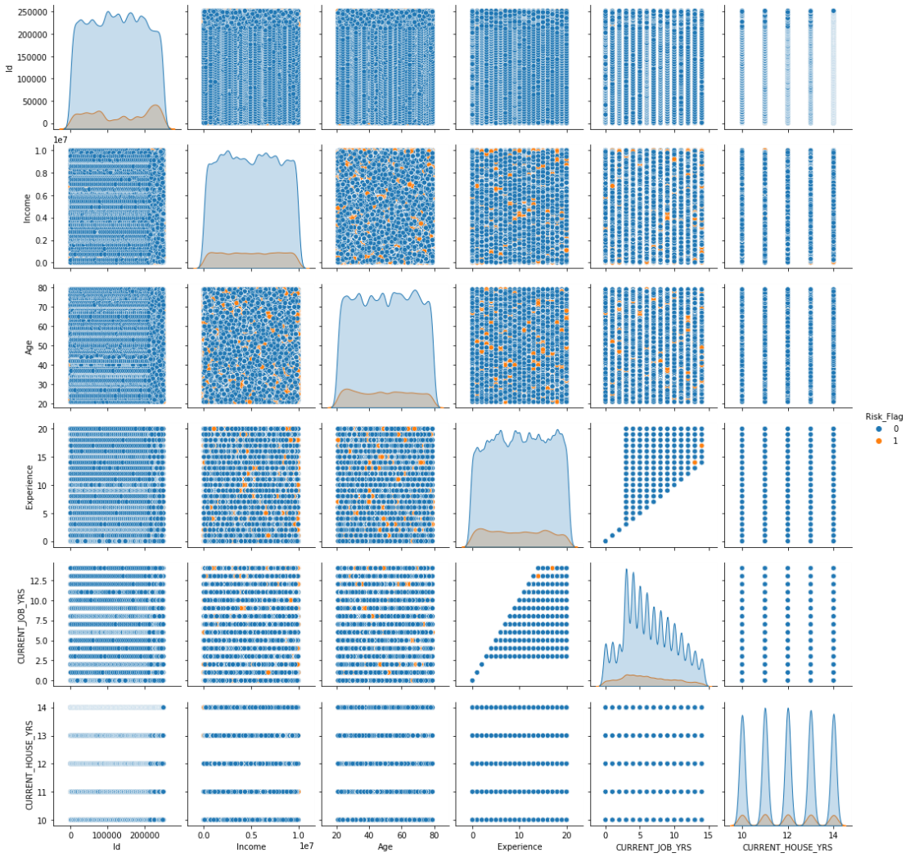
BIVARIATE ANALYSIS

Slide 8
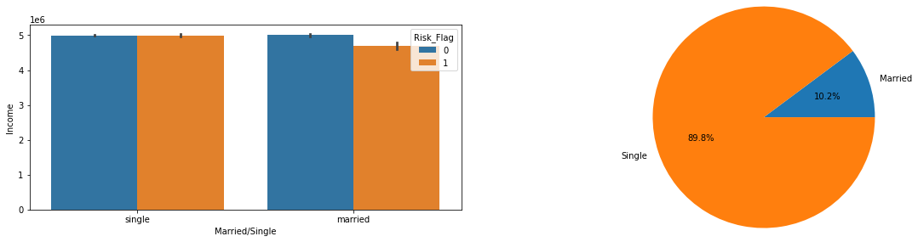
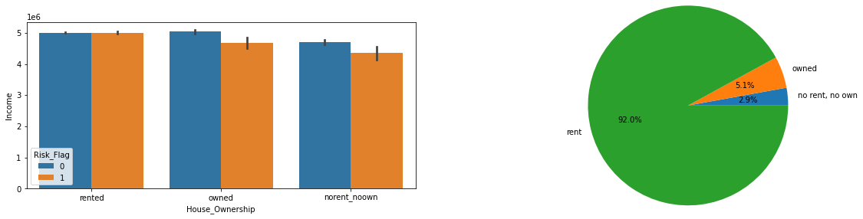
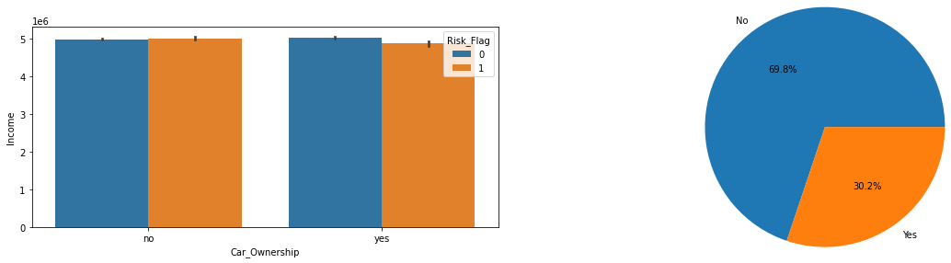
BIVARIATE ANALYSIS

Slide 9
EDA-OBSERVATIONS
CITY, STATE and Profession have high cardinality
The data was heavily imbalanced in favour of non-defaulters. Some form of sampling technique could be used to address the issue
No clear relationship between features can be noted and can be verified in correlation matrix
Some relationship is noticed between experience and current job years
We can deduce that features are not deeply inter-related
For the population that own a car, average income is slightly lower for defaulting category than in comparison to defaulting category
For the population that owns a house or neither owns non rents, average income is slightly lower for defaulting category than in comparison to defaulting category
The risk flag is dependent on all the 3 categorical features and hence we cannot drop the features in the pre-processing stage

Slide 10
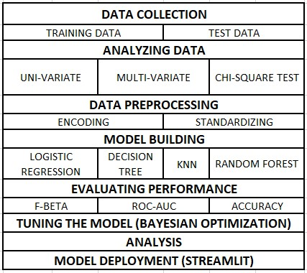
MODELING

Slide 11
DATA PREPROCESSING
Copying the complete database
Converting categorical features to numerical variables with the help of one hot encoding
Scaling numerical features with the help of min-max scaler
After pre-processing the data, the resulting database was of the shape (252000,407) for the train data and (28000,407) for the test data.

Slide 12
METRICS
F-BETA: F-measure with higher importance to beta score
Higher score is better. It helps us find whether we are coectly able to identify false negative values early on or not
ROC AUC SCORE: a probability curve that displays the TPR against the FPR at different threshold levels
Higher the ROC score, better our model will be in distinguishing between positive and negative class

Slide 13
ALTERNATIVES THAT WERE REJECTED
Accuracy for this reason will fail since the data is highly imbalanced.
Precision and Recall were two other good options to consider as metrics for model evaluation. However, they consider only specific part of confusion metrics and not the whole of it.
Since in model such as this, preventing false negatives and False Positives are of higher priority for a banker, F scores are much better evaluation.

Slide 14
MODELS & BASELINE EVALUATION
LOGISTIC REGRESSION
F_beta: ', 0.3245896392483197, ', Roc_Auc_Score: ', 0.5009341279648788
DECISION TREE
F_beta: ', 0.7245896392483197, ', Roc_Auc_Score: ', 0.8509341279648788
RANDOM FOREST
F_beta: ', 0.708125120123006, ', Roc_Auc_Score: ', 0.8374581278787493
K NEAREST NEIGHBORS
F_beta: ', 0.5021903203673405, ', Roc_Auc_Score: ', 0.7176228521691576

Slide 15
HANDLING IMBALANCED DATA
UP SAMPLING DATA
Upweighting means adding an example weight to the downsampled class equal to the factor by which you downsampled
DOWN SAMPLING
means training on a disproportionately low subset of the majority class examples

Slide 16
OVERSAMPLED DATA SCORE
Scores have increased after upsampling the data
Increase in score in case of decision tree is minimal as is the case in random forest as well
The score has drastically increased in Kneighbors and has become the best performing model.

Slide 17
EVALUATION
DECISION TREE
F_beta: ', 0.7245896392483197, ', Roc_Auc_Score: ', 0.8509341279648788
RANDOM FOREST
F_beta: ', 0.738125120123006, ', Roc_Auc_Score: ', 0.8674581278787493
K NEAREST NEIGHBORS
F_beta: ', 0.7521903203673405, ', Roc_Auc_Score: ', 0.8776228521691576

Slide 18
HYPER-PARAMETER TUNING
RANDOM FOREST: BEST FEATURES
N_ESTIMATORS: 1000
MIN SAMPLES_SPLIT: 10
MIN SAMPLE LEAF: 1
MAX FEATURES: AUTO
MAX DEPTH: 80
BOOTSTRAP: FALSE

Slide 19
REFERENCES
Ideal Loans and Problem Loans: Causes of Problem Loans
Redefining loan monitoring and early warning signal detection through an integrated solution
Detecting loan defaults at an early stage using models of machine intelligence
A Survey on Ensemble Model For Loan Prediction
An Ensemble Model of Multiple Classifiers for Time Series Prediction
Loan Credibility Prediction System Based on Decision Tree Algorithm
Weight-Selected Attribute Bagging for Credit Scoring
Loan default prediction using decision trees and random forest: A comparative study
A Survey of Machine Learning in Credit Risk
A study on predicting loan default based on the random forest algorithm
Business Analytics using Random Forest Trees for Credit Risk Prediction: A Comparison Study
Loan Prediction Model Using Logistic Regression, Decision Tree, Random Forest

